Slide 1

Data Analysis Board
CREDIT
MONITORING
UNIT
Presented By-
Group 7
Jai Singh
Abhijit Saikia
Himani Sunariya
Sanjeev Kumar Tripathi

Slide 2

Overview
Of Credit Monitoring Unit
The Credit Monitoring Unit is a Java based web application. It is designed to analyze data on basis of assigned parameters using graphs. For detail view data can also be viewed in data table.

Slide 3










Tools And Technology

Slide 4
Functionality
Display Data in Tables
Generating Graphs
Downloading Data

Slide 5
Application Architecture
Database:
27017
Eureka Server : 8761
Components
Service 1: 9995
Service 2: 8095
Kafka:
9092
Router
Service 3: 9996
Service 4: 8091
Service 5: 8093
Axios
Micro-Services
Frontend: 3000

Slide 6
Micro-Service Architecture
Eureka Server : 8761
Model
Repository
Kafka: 9092
Kafka Configuration
Service
Producer
Controller
DTO
Consumer
Micro-Service

Slide 7
Data Flow
Get Method
Controller
Service
Repository
Database
DTO
Controller
HTTP request OK
Kafka Templet
Kafka Topic

Slide 8
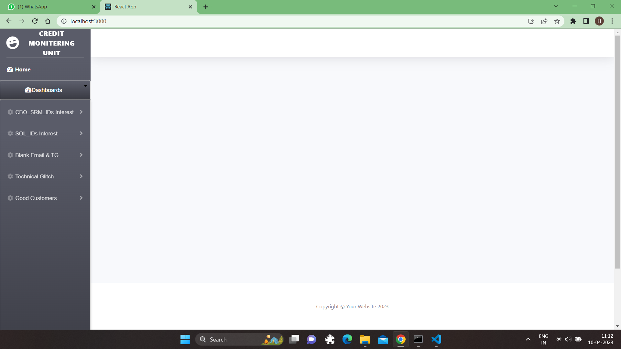
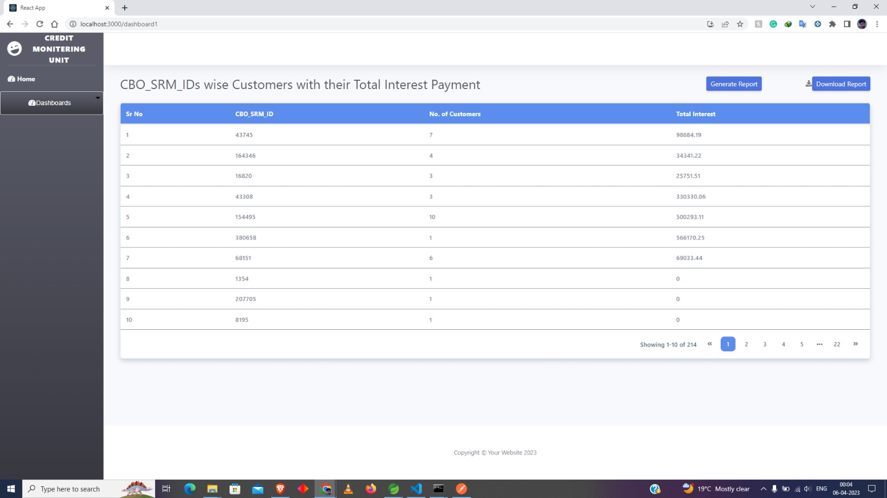
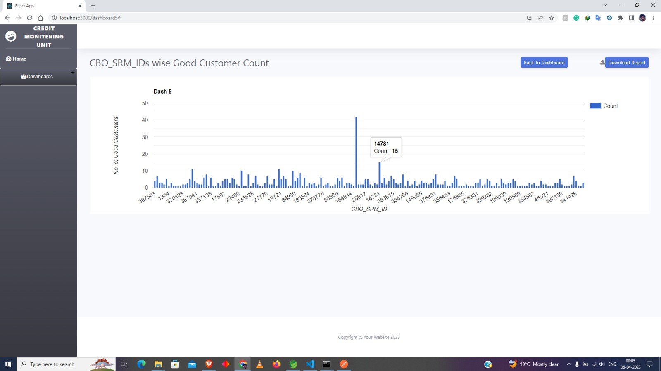
Front End Design
Home Page
Table
Charts

Slide 9
Services name-port number & Swagger APIs
EUREKA_SERVER : 8761 : http://localhost:8761/
DASHBOARD 1 : 9995 : http://localhost:9995/swagger-ui/index.html#/dad-controller/cbo
DASHBOARD 2 : 8095 : http://localhost:8095/swagger-ui/index.html#/dad-controller/cbo
DASHBOARD 3 : 9996 : http://localhost:9996/swagger-ui/index.html#/dad-controller/cbo
DASHBOARD 4 : 8091 : http://localhost:8091/swagger-ui/index.html#/dad-controller/cbo
DASHBOARD 5 : 8092 : http://localhost:8092/swagger-ui/index.html#/dashboard-controller/failureCaseCount
DASHBOARD 6 : 8093 : http://localhost:8093/swagger-ui/index.html#/dashboard-controller/failureCaseCount
React_APP : 3000 : http://localhost:3000/
MONGO_DB : 3036

Slide 10
Thank You

